Slide 1



UVA DSI Capstone Project
Wikimedia Foundation, Trust & Safety
Cyber Harassment Classification & Prediction of User Account Blocks
Students - Charu Rawat , Arnab Sarkar, Sameer Singh
Faculty Advisor – Rafael Alvarado University of Virginia Master’s in Data Science Program
Clients – Patrick Earley , Sydney Poore
Advisor – Lane Rasberry
Trust and Safety Team, Wikimedia Foundation

Slide 2
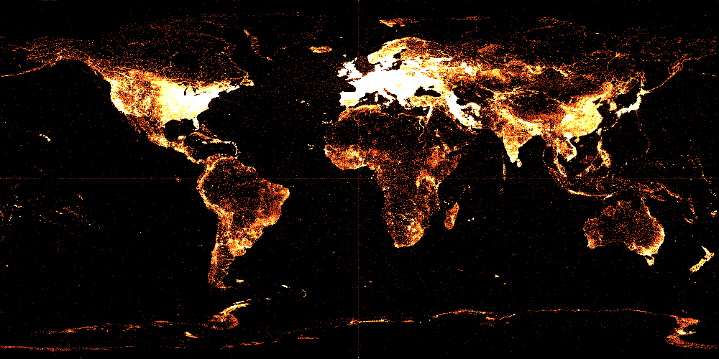
The English Wikipedia over the last few years…
Languages: 250+
Popularity: Alexa Rank #5
Total Edits: 868,717,569
All Pages: 46,612,179
Articles 5,767,464
Registered Users: 35,185,308
Administrators: ~1,193
https://commons.wikimedia.org/wiki/File:Wikidata_Items_Map_2014_%E2%80%93_2017_gif.gif

Slide 3


Online Harassment at Wikipedia
Pew Research Centre Survey (America centric)
41% have experienced personal attacks
66% observed attacks directed towards others
47% reported a decrease in contribution and engagement levels

Slide 4

Problem
Currently - Human Driven Process
Failure to identify bad behavior
Bias to overlook such behavior
Inability to understand context and scope of problem
As the Wikipedia community continues to grow in its size and diversity, the current human-driven process will not scale effectively and will be insufficient in combatting harassment, impeding the community's growth.
Hence, there’s a need for a more robust methodology to combat harassment.
https://commons.wikimedia.org/wiki/File:10_sharing_book_cover_background.jpg

Slide 5


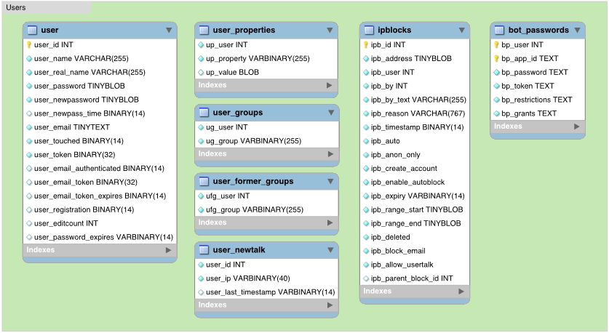
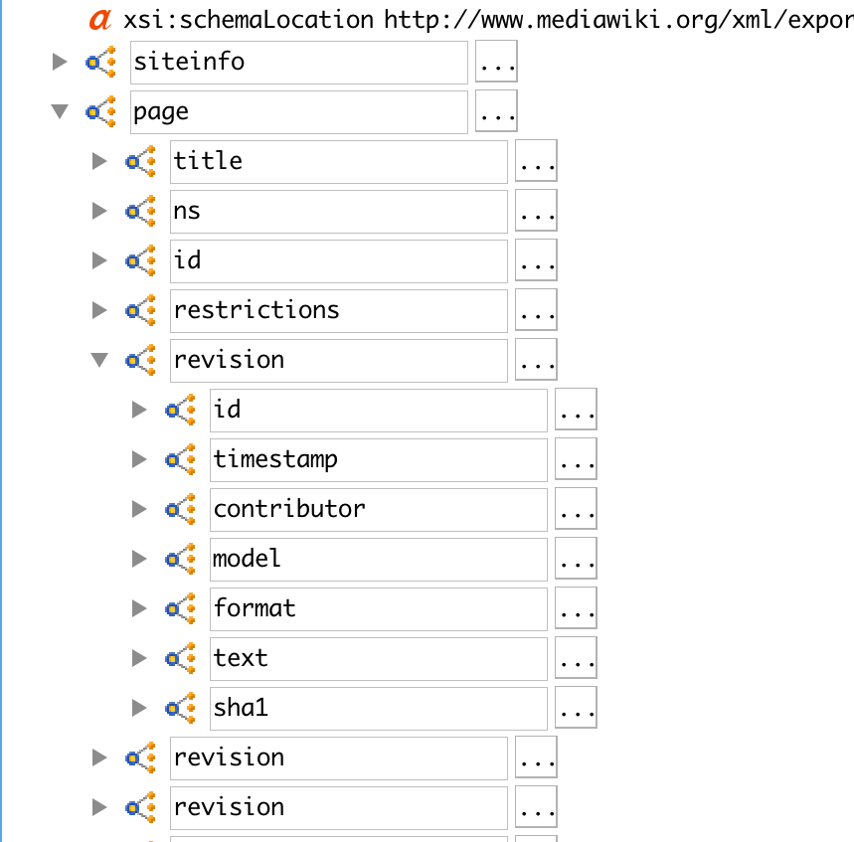
Data Sources
Toolforge
Wikipedia Data dumps
Format: MariaDb
Blocked user list, and User activity statistics
Format: XML files
Revision text

Slide 6





Data Pipeline
Web scraping and sequential downloading
Data Storage
and Manipulation
SSH tunneling to transfer data
Data Challenges
Database size
5TB+ files
Article and User
talk namespace
Annotation
No clean mapping
Focus on top block reasons
Abusive text identification
Days lag, multiple sources
Iterative process

Slide 7




Data Model
Revision Text
user
timestamp
revision_text
User Blocks
Ibp_user
Ibp_timestamp
Ibp_reason
Ibp_expiry
User Activity
rev_user
rev_timestamp
rev_length
rev_minor_edit
Extracting user text using ‘difflib’
Identifying block reasons using ‘regex’
Extracting aggregated weekly activity statistics
Final Corpus
Revision text extraction:
Revision history
Raw Diff
Labelled Text
Uncompressing, and using
Difflib library
Cleaning, and merging
with block data

Slide 8
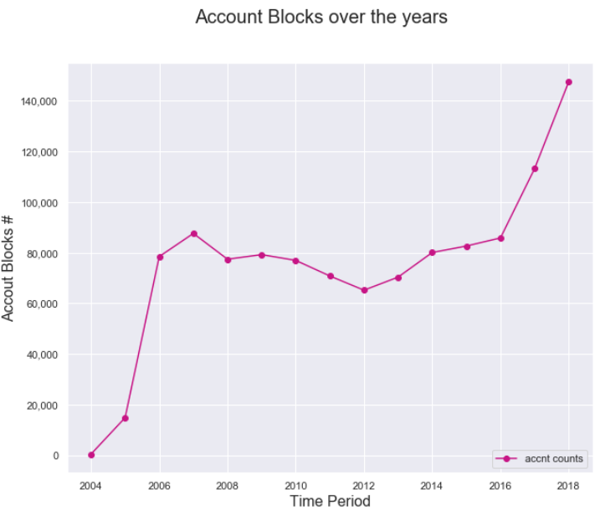
Account blocks over the years

Slide 9
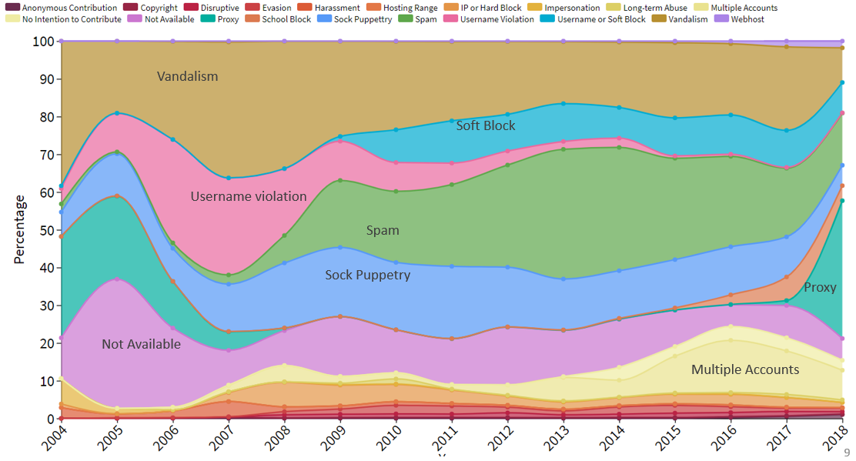
Share of reasons for account blocks over the years

Slide 10
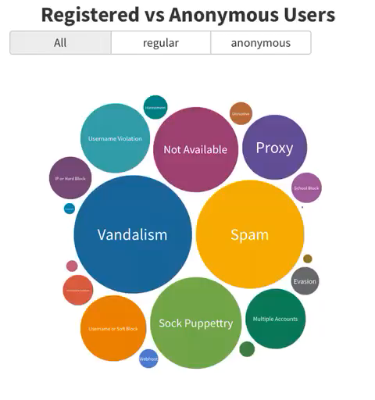

Slide 11
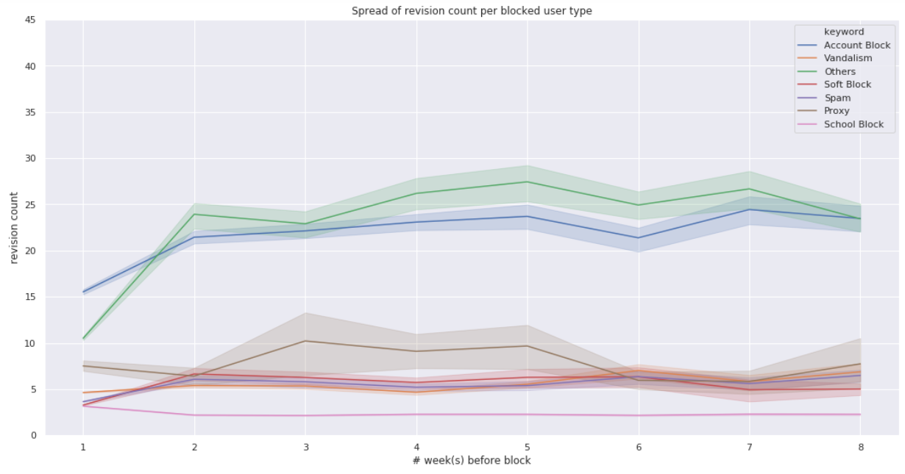
Revision activity of blocked users in their recent 8 weeks
Number of Revisions

Slide 12
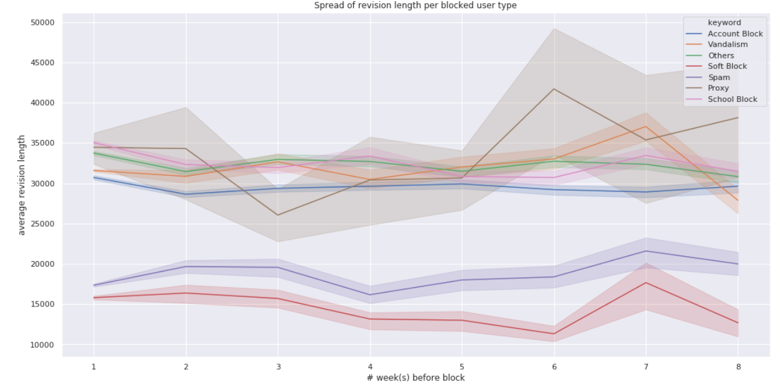
Revision activity of blocked users in their recent 8 weeks
Revision Length

Slide 13
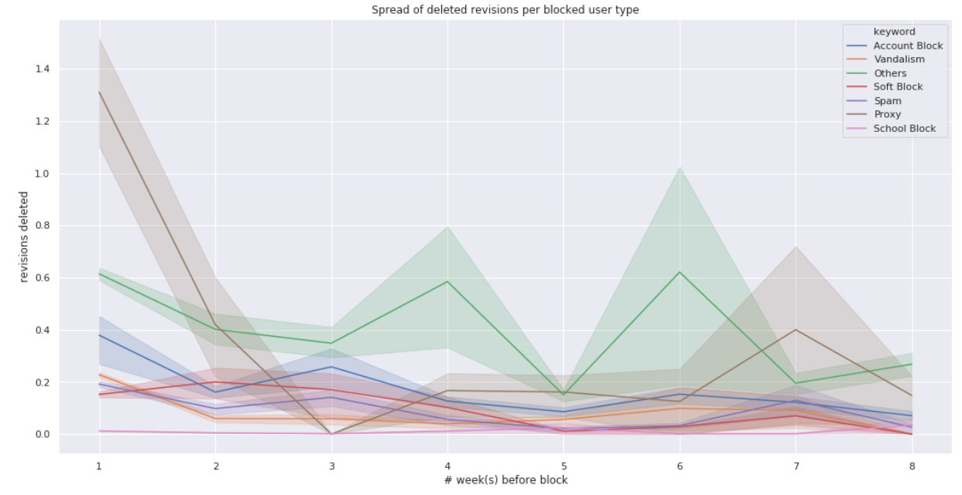
Revision activity of blocked users in their recent 8 weeks
Deleted Revisions

Slide 14
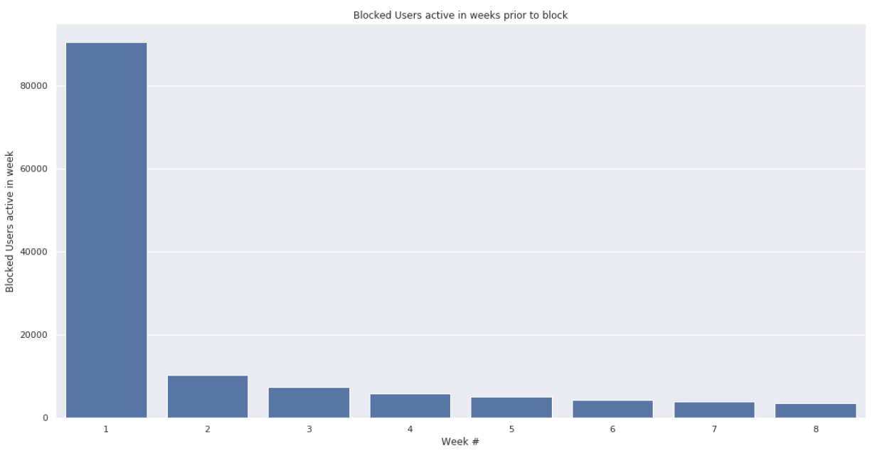
Blocked user active status in recent 8 weeks - Weekly
90,442
10,317
7,499
5,937
5,102
4,309
3,872
3,554
92.3 % of all blocked users are definitely active in the week prior to their block

Slide 15
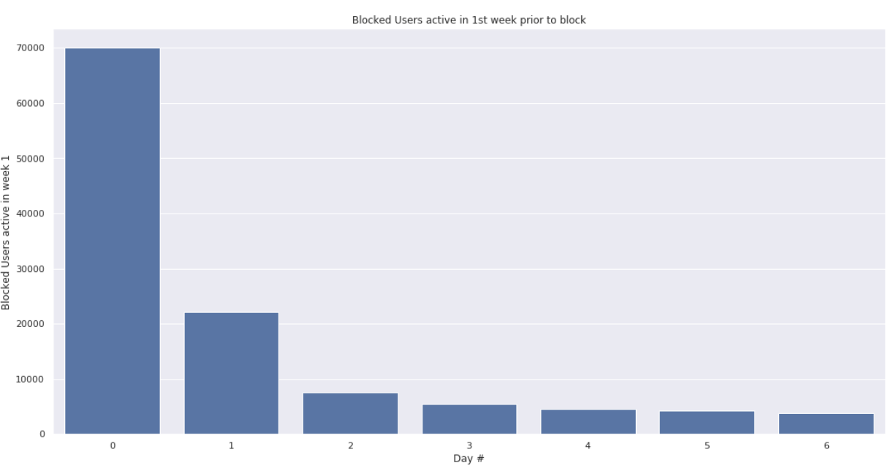
Blocked user active status in recent 8 weeks - Daily
69,985
22,155
7,482
5,499
4,520
4,196
3,827
77.3 % of users are active only on the day of their block
24.5 % of users are active 1 day prior to their work

Slide 16

Conclusion
User Block data –
Differentiation in blocks for anonymous vs registered users
Increase in bot activity in late 2018 leading to proxy blocks
Revision History –
Additional non textual features.
Future Tasks
User Activity Data
Extracting non textual features
Revision Data
Text Processing/NLP for feature extraction (lemmatization, word2vec, ngrams, tfidf, LDA)
SVM?
Neural Networks ?
Final Classification Model
Logistic regression ?
16

Slide 17
References
[1] “Wikipedia Statistics”. Available: https://en.wikipedia.org/wiki/Special:Statistics. [Accessed: 09/23/2018]
[2] “Wikimedia Community Engagement Insights, 2018 report.” Available: https://meta.wikimedia.org/wiki/Community_Engagement_Insights/2018_Report/Support_%26_Safety
[Accessed: 09/24/2018]
[3] “Wikipedia Official Website”. Available: https://www.wikimedia.org/. [Accessed: 09/22/2018]
[4] M. Duggan. “Online harassment. Pew Research Center, 2017”. Available: http://www.pewinternet.org/2017/07/11/online-harassment-2017/. [Accessed: 09/22/2018]
[5] “Wikipedia. Wikimedia: Wikimedia Harassment”. Available: https://en.wikipedia.org/wiki/Wikipedia:Harassment. [Accessed: 09/23/2018]
IMAGE References –
Slide 2 - https://commons.wikimedia.org/wiki/File:Wikidata_Items_Map_2014_%E2%80%93_2017_gif.gif
Slide 4 - https://commons.wikimedia.org/wiki/File:10_sharing_book_cover_background.jpg
Slide 5 - https://www.mediawiki.org/wiki/Manual:Database_layout
Icons across slides - https://www.flaticon.com

Slide 18

Q/A

